Slide 1

Marketing Strategy

Slide 2

Agenda & Purpose
Purpose:
  Present the strategy & focus areas for WBE for the next year
Agenda:
  Marketing Strategy Review
  Proposed Action Plan
  Next Steps

Slide 3
Marketing Strategy - Overview
Marketing Foundation:
  Define the personas for WBEs and Corporates:
    WBEs - different personas for Certification & Pre-Certification levels, new niche industry personas
    Corporates: Break out Corporates into two personas: Corporate & Public Sector
  Adjust messaging to be more accessible and relatable to all women business owners & update on website, social media, and key marketing assets
  More clearly communicate the levels for WBEs (Certification & Pre-Certification (Tools for Growth) & help prospective WBEs decide which is for them
New Marketing Funnels & Processes:
  Create new marketing funnels for each persona:
    WBEs (main funnel + niche funnel)
    Corporate
    Public Sector
  WBE funnel designed to:
    Get more prospective WBEs on the initial email list
    Convert them to Certification or Pre-Certification (Tools for Growth) level
    Convert Pre-Certification (Tools for Growth) sign ups to Certification
  Similar for corporates and public sector
Marketing Outreach:
  Generate more awareness of WBE Canada:
    SEO to capture potential WBEs and Corporates while searching
    Content marketing, Social Media, Hub Pages
    Facebook Advertising + Group Participation
    LinkedIn Networking + Group Participation
    Business, women’s, and trade associations - sponsorship, advertising, events, other participation
  Targeted Campaigns:
    Target key WBE niches with specific messaging around their industry - eg Construction, etc.
    Reach more corporates and public sector partners through association marketing

Slide 4
Background & Research
  WBE, Corporate & Team interviews and insights summaries
  Competitive & market review
  Total Online Presence Review
  Key findings and recommendations (strategy first interim meeting)

Slide 5
Marketing Strategy
Goals

Slide 6
Goal: Clarify WBE Messaging
  Challenge: Many WBEs who land on the website or social media pages may not be converting to sign-ups or Certification applications because the current messaging for potential WBEs:
    May be too technical and use insider terms that all WBEs may not be familiar with (supplier diversity, procurement)
    May not position WBE as different from other women organizations.
  Goal: Use plain language that all WBEs can relate to and clearly differentiate WBE Canada from other women business organizations
  Action Steps: New messaging guide, updated messaging on the website and in key online and foundational marketing assets.

Slide 7
Goal: Clarify WBE Levels
  Challenge: Potential WBEs may not realize there are two paid participation levels with WBE Canada: Certification & Pre-Certification (Tools for Growth), and WBE Canada may be missing an opportunity to convert more potential WBEs to sign up for the lower priced entry level option.
  Goal: Make the two levels more clear, and encourage more WBEs who aren’t ready for Certification to sign up for Tools for Growth
  Action Steps: Create two WBE personas (Certification & Pre-Certification), create checklist or similar to help potential WBEs take action, update key areas of the website to make these levels more clear.

Slide 8
Goal: Get More Potential WBE Email Sign-Ups
  Challenge: The current offer on the website to get more WBEs on the email list is a generic newsletter sign up form. There is no compelling offer to get potential WBEs on the email list so they can eventually convert to Certification or Pre-Certification (Tools for Growth)
  Goal: Get more potential WBEs on the email list as a first step to increasing conversions.
  Action Steps: Create a new offer (free guide to accessing corporate & government contracts or similar), update the email sign up form on the website, and add a Thank You page and email auto-responder

Slide 9
Goal: Convert More WBEs to Certification
  Challenge: Once potential WBEs get on the email list, there is no nurturing sequence to encourage them to take more action and convert to Certification.
  Goal: Get more potential WBEs to convert from an email sign-up to applying for Certification.
  Action Steps: Create an email nurture sequence of 4 to 6 emails to encourage new email sign-ups to convert to Certification Applications.

Slide 10
Goal: Convert More WBEs to Tools for Growth
  Challenge: If a potential WBE is either not ready for Certification or is not convinced to Certify through the initial email sequence, there is a missed opportunity to have them join WBE at a lower risk paid level (Tools for Growth) in order to help them either get ready for Certification - or encourage them to apply.
  Goal: Get more potential WBEs who don’t take action to apply for Certification to sign up for Tools for Growth.
  Action Steps: After the main WBE certification email nurture sequence is complete, send a follow up email encouraging sign-up for Tools for Growth. Create a six month sequence of six monthly emails to encourage sign ups for Tools of Growth/Apply for Certification

Slide 11
Goal: Increase Awareness with Potential WBEs
  Challenge: Lack of awareness of WBE Canada in general with many women business owners across Canada.
  Goals: Increase awareness of WBE Canada with women business owners and referring organizations across Canada.
  Action Steps: General awareness campaign targeted to all Women Owned Businesses through persona Hub Pages, SEO, social advertising, content marketing, and event/association marketing. While we aren’t specifically targeting Corporates, this campaign will have a residual awareness impact.

Slide 12
Goal: Increase WBE Certifications through General Outreach
  Challenge: WBE Canada needs to significantly increase its base of Certified WBEs.
  Goals: Get more new potential WBEs to apply for Certification, either right away or by first signing-up for the email list or purchasing Tools for Growth, and then going through the email nurture sequence to convert to applying for Certification
  Action Steps: Create targeted campaigns aimed at the main WBE Certification persona:
    Direct response social advertising (LinkedIn, Facebook)
    Social Outreach
    Direct Response Association/Event Marketing

Slide 13
Goal: Increase WBE Certifications through Targeted Niche Outreach
  Challenge: WBE Canada needs to significantly increase its base of Certified WBEs in specific target niches where they have Corporate Buyers (such as construction)
  Goals: Get more new potential WBEs in targeted industry niches to apply for Certification, either right away or by first signing-up for the email list or purchasing Tools for Growth, and then going through the email nurture sequence to convert to applying for Certification
  Action Steps: Create targeted campaigns aimed at individual WBE Niche personas (such as construction):
    Identify key industry associations, events and publications/online assets
    Create an association marketing kit (templates)
    Direct response social advertising (LinkedIn, Facebook)
    Social Outreach
    Direct Response Association/Event Marketing

Slide 14
Goal: Attract & Convert More Corporate Buyers
  Challenge: WBE Canada would like to onboard more corporate buyers. While the marketing and messaging on the corporate side is currently highly effective, there may be “marketing gap” for some public sector buyers who may not resonate with the more corporate language.
  Goal: Attract and convert more buyers from the public sector by adjusting messaging to reflect their core values.
  Action Steps: Create two marketing personas: Corporate Buyer and Public Sector Buyer, along with marketing hubpages/landing pages for each and customized messaging to better resonate with the public sector buyer.

Slide 15
Goal: Engage & Retain More WBEs & Corporate Buyers
  Challenge: Some current WBEs & Corporate Buyers are not reading emails from WBE Canada or participating in WBE activities. The interviews indicate that some WBEs may have an expectation gap in terms of what they expected to get from WBE Canada and what they did get.
  Goals: Set the right expectations with WBEs right from the beginning so they know exactly what WBE Canada will do for them, and what they need to also do in order to get the value they want. Create a new way of communicating with WBEs to encourage participation and engagement.
  Action Steps: Create a Welcome Kit/Onboarding guide for WBE Canada Staff to use with new WBEs. Create a new Communication Guide & Process for WBE Staff to use.

Slide 16
Marketing Strategy
Overview

Slide 17
Marketing Challenges
  Lack of awareness of WBE in general with WOBs
  Lack of awareness of what supplier diversity is, and the opportunity for WOB
  Misconceptions about what WBE really is and the benefits for WOBs
  Messaging may not be clear for some WOBs
  Different membership levels may not be clear for WOBs
  WOBs are so diverse, targeting with a general message is challenging
  Some internal challenges (such as email) may be impacting participation, retention and referrals

Slide 18
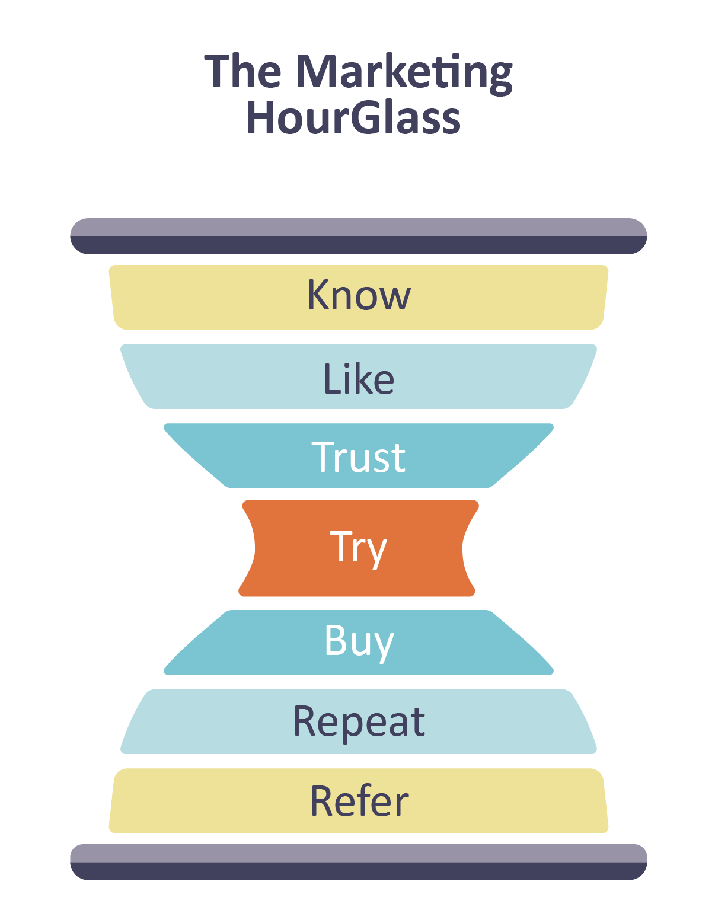

Marketing Strategy Overview Customer Journey

Slide 19
Strategy: Your Customer/Member Journey
WBEs:
Know | Like | Trust | Try | Buy | Repeat | Refer
Not much - BDC, other contracts | Messaging, Videos, People, Mission | Case studies, examples, results, people | Low: Newsletter Sign Up Mid: Tools for Growth Videos, Events, etc. | Membership, Certification Application, Onboarding Processes, Initial Ramp Up & Training | Member retention, engagement | Great experience, get what they expected
Biggest gap - Big Opportunity | Messaging gap - Big Opportunity | Good - Need More | Big opportunity | Improvements | Improvements | Improvements

Slide 20

Marketing Strategy Overview
Marketing Foundation
Clear Plain Language
Messaging
Website & Online Assets
Personas
Foundation Content
Awareness Campaigns:
SEO/Google Ads
Persona Hub Pages
Video
New Personas & Marketing Funnels
WBE Certification
WBE Targeted Niche
Corporate
Public Sector
Lead Nurture Sequence
for each persona
Book a Call/Sign Up
Targeted Outreach::
Social Ads
Events/Associations
Newsletter
Content Marketing
Ongoing Content + Social Sharing
Re-Engagement

Slide 21
Marketing Foundation
Actions

Slide 22
Marketing Foundation Actions
PERSONAS
Define the personas for WBEs and Corporates:
WBEs:
Break out personas for Certification & Pre-Certification
Niche personas for key market segments
Corporates:
Corporate
Public Sector
MESSAGING
Adjust messaging to be more accessible and relatable to all women business owners
Create new messaging guide
Update messaging on website, social media, and key marketing assets
WBE Certification Levels
More clearly communicate the two WBE levels:
Certification
Pre-Certification (Tools for Growth)
Help prospective WBEs decide which level is for them:
Get more initial sign-ups at the Pre-Certification level
Prepare & move initial sign ups to Certification

Slide 23

Messaging Challenges
With the current high level messaging, Women Owned Businesses may not immediately understand:
  Who WBE Canada really is and the benefits for WBEs
  How WBE Canada is unique to other women business networking groups
  Some terminology, such as supply chain diversity & procurement
  The correct path for them immediately - Certification or Pre-Certification (Tools for Growth)
  WHY they should be Certified and what it can do for them
Insights:
Need clear, high level messaging that resonates with WBEs and immediately grabs attention

Slide 24
Messaging Action Steps
  Create a new messaging guide
  Update the high level messaging on the website, social pages and key marketing assets to:
    Replace more technical terms with plain language that all WBEs can related to & immediately understand
    Immediately communicate the core benefits of WBE Canada
    Position WBE Canada as an important & credible industry council and different from other women business organizations
    Clearly communicate Certification options & the the next best action step for WBEs
Insights:
Strong opportunity to engage more WBEs through clear messaging that speaks to benefits in plain language

Slide 25
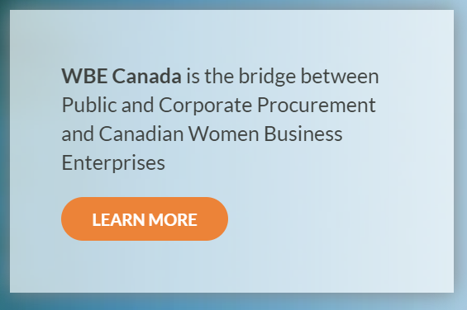
Messaging Core message example
WBE Canada is the Certifying Council for Women Owned Businesses:
Get best practices resources to thrive & scale.
Access corporate & government contracts with organizations who want to work with more Women Owned Businesses.
Connect, partner & mentor with other women business owners.

Slide 26
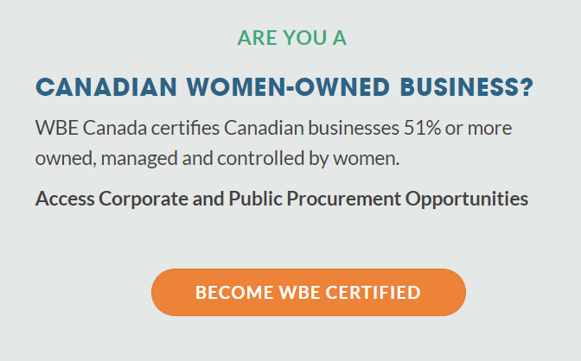
Messaging Example
ARE YOU A
CANADIAN WOMEN-OWNED BUSINESS?
WBE Canada is the Certification Council in Canada for businesses 51% or more owned, managed & controlled by women.
Access corporate & public contracts with organizations looking to work with more Women Owned Businesses like you:
Get WBE Certified Now

Slide 27
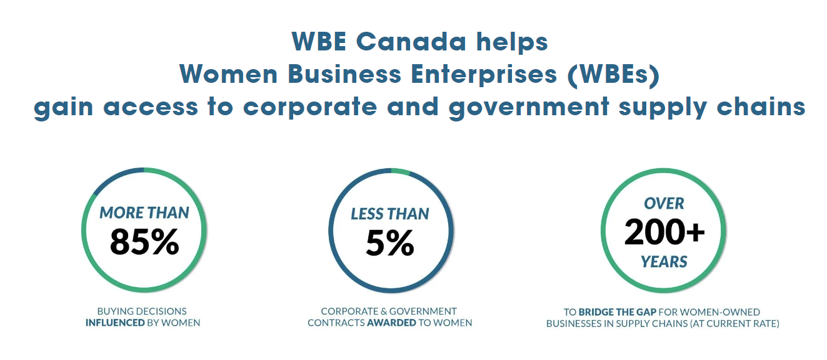
Messaging Example
WBE Canada helps
Women-Owned Businesses
access corporate & government contracts

Slide 28
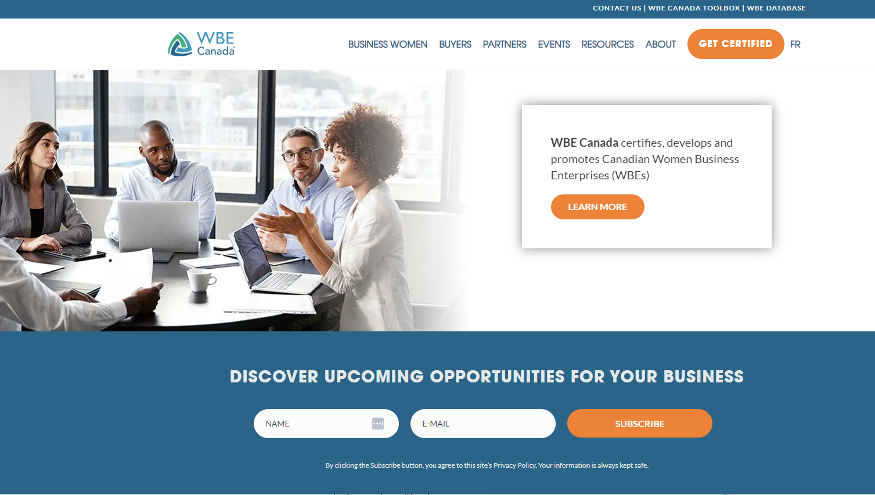
Messaging Example
WBE Canada is the Certifying Council for Canadian Women-owned Businesses:
Access corporate & government contracts with organizations
who want to work with more women-owned businesses.
Get best practices resources to thrive and scale.
Connect, partner & mentor with other women business owners.

Slide 29

Certification Levels Example
  Make the options clear on the Home Page

Slide 30
Certification Levels Challenges
  Women Owned Businesses can join WBE in two paid ways:
    Pre-Certification - Tools for Growth ($197)
    Certification ($750+)
  The current positioning of the pre-certification level is “Tools for Growth”:
    It may not be clear that potential WBEs can join at this level, or that this level exists
    Making this level more clear would encourage more potential WBEs to take a first step lower risk paid option to participate with WBE
  Getting more WBEs to join at this level provides an opportunity to help them prepare & move to Certification

Slide 31
Certification Levels Action Steps
  Website Home Page: Update the website homepage to make the two certification levels clear:
    Messaging around the two levels and when/why to join each
    A checklist to know which level to join
  Navigation: Update the website navigation drop down to clarify the two levels
  Website Get Certified Page: Update the Get Certified page to give an option to join at the pre-certification (Tools for Growth) level
  Tools for Growth Page: Update the Tools for Growth page to position it as a way to join WBE Canada at a lower cost and access the Tools For Growth that will prepare them for scaling and Certification

Slide 32
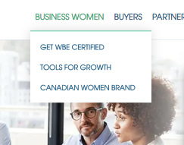
Certification Levels Action Steps
  Recommend making the two levels of participation more clear on the website
  Help WOBs choose the level that is right for them
  Move more WOBs who aren’t ready for Certification into the membership stream to get prepared
BECOME A MEMBER
GET WBE CERTIFIED
BECOME A MEMBER
GET WBE CERTIFIED

Slide 33
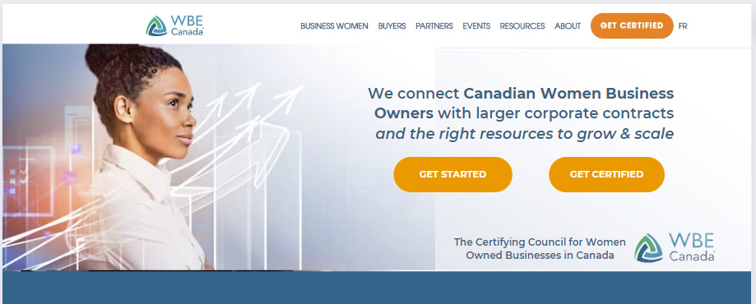
Certification Levels Example
  Make the options clear on the Home Page

Slide 34
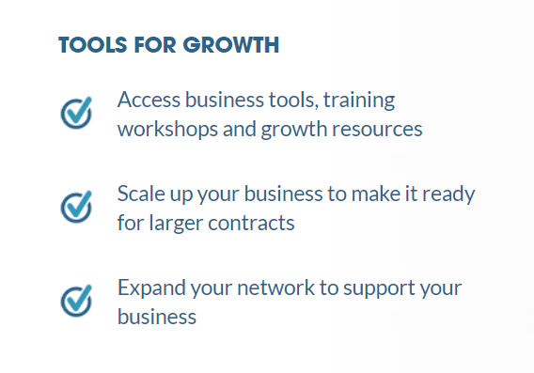
Certification Levels Action Steps
  Update messaging on Tools for Growth page
  Include options to apply for Certification on the Tools for Growth Page
JOIN WBE CANADA NOW:
Not Ready for Certification? Get started & prepare for Certification with our Tools for Growth:

Slide 35
New Personas & Marketing Funnels

Slide 36
New Personas & Marketing Funnels
  Current Situation:
    WBE Canada has two main marketing personas: Women Owned Businesses and Corporates
  Recommendation:
    Separate out Women Owned Businesses into two personas:
      WOB ready for certification (Certification)
      WOB not ready for certification (Pre-Certification)
    Create Niche WBE Personas
    Separate out Corporates into two personas:
      Corporates
      Government/Public Sector

Slide 37
WBE Personas
WBE PERSONA 1:
CERTIFICATION
Women-owned businesses ready to be certified & work with corporates with or without support & training
In business for three plus years
Steady client base
Systems & processes in place
Managing resources or teams
Managing finances
Incorporated (or could be)
Industry where corporate contracts make sense
WBE PERSONA 2:
PRE-CERTIFICATION
Women-owned businesses not yet
ready to work with corporates
In business less than three years (or longer if part time/on the side)
May have a steady client base, but lack systems & processes
May have systems & processes but have a sporadic client base
Sole proprietor but wanting to incorporate
Want to scale and grow

Slide 38
Main WBE Funnel (Certification Persona)
  Main persona
  Main CTA on website
  Most lead generation activities will drive to this funnel
Funnel Includes:
  Main Landing Page, CTA, Thank You Page
  Auto Responder Email
  Four Email Nurture Sequence with CTA to Book a Demo
  Once Sequence is Complete - Move to Ongoing Newsletter
  Consider Monthly Re-Engagement Emails

Slide 39
Main WBE Funnel Detail
If you thought larger contracts were out of reach, think again…
Content Marketing & Social Media
Website Landing Page/CTA:
Get the Women Business Owner’s Guide to Accessing Corporate & Govt. Contracts in Canada
Ready?
Book a Call/Apply
Why you’re in demand as a Canadian women-owned business
SEO/Hub Pages
5 Ways Corporate & Government Contracts Can Help Your Business
PPC & Social Ads
Ready to grow & scale your women-owned business? These are the tools you need…
Not Ready? Tools for Growth
Events/Associations
How WBE Canada Certification Has Helped These Women-Owned Businesses…
Are You Ready to Certify Your Women-Owned Business?

Slide 40
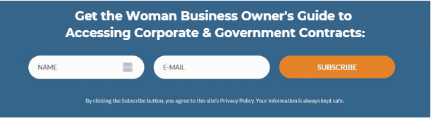
Main WBE Funnel Website CTA Example
WBE Canada is the Certifying Council for Canadian Women Owned Businesses:
Access corporate & government contracts with organizations who want to work with more Women Owned Businesses.
Get best practices resources to thrive & scale.
Connect, partner & mentor with other women business owners.
GET STARTED
GET CERTIFIED

Slide 41
WBE 6 Month Conversion Nurturing
  Conversion funnel after the WBE Certification Funnel
  Goal is to continue to encourage WBEs who don’t apply for Certification after the first lead nurturing sequence to apply or to get started with Tools for Growth
Funnel Includes:
  Targeted email to sign up for Tools for Growth immediately following the Certification Nurturing Sequence
  Six monthly emails to encourage conversions to Certification or Tools for Growth
  Once Sequence is Complete - Move to Ongoing Newsletter

Slide 42
WBE 6 Month Conversion Nurturing
Funnel Detail
Month 2: Re-engagement email
Targeted Email:
Not Ready for Certification? Get Started with Tools for Growth
Month 3: Re-engagement email
WBE Certification Funnel
(went through certification funnel but did not book call or sign up for certification)
Purchase Tools for Growth/Join WBE Canada
Month 4: Re-engagement email
Month 5: Re-engagement email
Newsletter
Month 6: Re-engagement email

Slide 43
WBE Target Niche Funnel
  Campaign funnel for targeted WBE niches (example - construction)
  Goal is to attract more WBEs from specific niche industries
Funnel Includes:
  Landing Page with a CTA and Thank You Page
  Auto Responder Email
  Four Email Nurture Sequence with CTAs to:
    Apply for Certification/Book a Certification Call
    Sign up at the Pre-Certification Level (Tools for Growth)
  Once Sequence is Complete - Move to Conversion Funnel, then Monthly Newsletter

Slide 44
WBE Target Niche Funnel Detail
If you thought larger corporate contracts in construction were out of reach, think again…
Ready?
Video/ Book a Call
Why you’re in demand as a Canadian women-owned construction business
Website Landing Page/CTA:
Get the Women Business Owner’s Guide to Accessing Corporate Contracts in Construction
Targeted
Campaigns
Construction Associations & Events
Social Media & Ads
5 Ways Corporate Contracts Can Help Your Construction Business
Companies like (Name) are looking to work with Certified Women Owned Businesses
Not Ready? Move to Tools
How WBE Canada Certification has helped these women-owned businesses in construction…
Are You Ready to Certify Your Women-Owned Construction Business?

Slide 45
Corporate & Public Sector Personas
PERSONA 1: CORPORATE
Private & Public Mid to Large Size Businesses
Currently have a supplier diversity program in place, or are actively looking to build a program
Large enough to have a procurement department/team
Prepared to hire or potential to hire WBEs
Any industry where hiring WBEs makes sense
Value profit, growth, shareholders along with strong public image
PERSONA 2: Public Sector
Public Sector/Government Organizations/Crown Corporations
Currently have a supplier diversity program in place, or are actively looking to build a program
Municipal, regional & federal government
Education, healthcare, transportation
Prepared to hire or potential to hire WBEs
Value serving their public, balanced budget, being good citizens

Slide 46
Corporate Funnel
  New Hub Page and other SEO/Awareness marketing will drive to this funnel
  Can be used for test campaigns in the future
Funnel Includes:
  SEO Hub Page with a CTA and Thank You Page
  Auto Responder Email
  Four Email Nurture Sequence with CTA to Book a Consultation
  Once Sequence is Complete - Move to Ongoing Newsletter

Slide 47
Corporate Funnel Detail
5 Reasons to Start Your Supplier Diversity Program Now
Main CTA:
How to Set Up Your Supplier Diversity Program in Canada
Are you supporting Canadian Women Owned Businesses?
Book a Call
SEO/Hub Pages
The 6 Myths of Supplier Diversity (and what they may be costing you)
Awareness Campaigns
Boost Your Corporate Profile by partnering with WBE Canada
Newsletter
BMO Canada (or other) Case Study
Partner With WBE Canada Now

Slide 48
Public Sector Funnel
  New Hub Page and other SEO/Awareness marketing will drive to this funnel
  Can be used for test campaigns in the future
Funnel Includes:
  SEO Hub Page with a CTA and Thank You Page
  Auto Responder Email
  Four Email Nurture Sequence with CTA to Book a Consultation
  Once Sequence is Complete - Move to Ongoing Newsletter

Slide 49
Public Sector Funnel Detail
Why Women Owned Businesses Need to Be Part of Your Supplier Diversity Program
Main CTA:
How to Set Up Your Supplier Diversity Program in Canada
Support Women-Owned Businesses by partnering with WBE Canada
Book a Call
SEO/Hub Pages
City of Toronto (or other) Case Study (benefits of working with WBE Canada)
Awareness Campaigns
Profiles of Certified WBEs
Newsletter
Partner With WBE Canada Now

Slide 50
Marketing Outreach
& Targeted Campaigns

Slide 51
WBE Outreach Campaign WBE Certification Persona
  Challenge: WBE Canada needs to significantly increase its base of Certified WBEs.
  Goals: Get more new potential WBEs to apply for Certification, either right away or by first signing-up for the email list or purchasing Tools for Growth, and then going through the email nurture sequence to convert to applying for Certification
  Action Steps: Create targeted campaigns aimed at the main WBE Certification persona:
    Direct response social advertising (LinkedIn, Facebook)
    Social Outreach
    Direct Response Association/Event Marketing

Slide 52
WBE Outreach Campaign: Messaging Example
  For more general outreach to all women business owners, focus on messaging that clearly differentiates WBE and sets you apart from typical networking groups they may be familiar with, and focuses on WBEs core difference and supporting benefits:
Are you a Canadian Women-Owned Business?
Do you want to access larger contracts with corporations and the government?
Get started with WBE - the Certifying Council for Women-Owned Businesses in Canada
Are you a Canadian Women-Owned Business but think larger corporate & government contracts are out of reach? Think again…

Slide 53

WBE Outreach Campaign: Ad Examples

Slide 54

WBE Outreach Campaign: Ad Examples

Slide 55


WBE Outreach Campaign: Ad Examples

Slide 56



WBE Outreach Campaign: Ad Examples

Slide 57
Targeted Campaigns: Association Marketing Kit
  Create an association marketing kit WBE Canada
  Marketing kit will include:
    Messaging guide and key message snippets to use
    Logo and branding guide and assets
    News release template
    Advertising template
    Marketing sheet template
    Email template

Slide 58
Targeted Campaigns: Association Marketing Example
  Identify associations to target
  Review options for events, advertising, and other marketing opportunities
  Select one association to target each month
  Select best marketing activities to pursue
  Execute marketing activity using the Association Marketing Kit templates
  Drive all marketing activities to the Niche landing page and funnel

Slide 59
Targeted Campaigns WBE Niche Personas
  Challenge: WBE Canada needs to significantly increase its base of Certified WBEs in specific target niches where they have Corporate Buyers (such as construction)
  Goals: Get more new potential WBEs in targeted industry niches to apply for Certification, either right away or by first signing-up for the email list or purchasing Tools for Growth, and then going through the email nurture sequence to convert to applying for Certification
  Action Steps: Create targeted campaigns aimed at individual WBE Niche personas (such as construction):
    Identify key industry associations, events and publications/online assets
    Create an association marketing kit (templates)
    Direct response social advertising (LinkedIn, Facebook)
    Social Outreach
    Direct Response Association/Event Marketing

Slide 60
Targeted Niche Campaigns: Messaging Example
  Create high level messaging specific to the niche industry you are targeting:
Are you a Canadian Women-Owned Business in the Construction Industry?
Corporate & government contracts are available now with organizations who are actively looking to work with more women-owned businesses in construction.
Get started with WBE - the Certifying Council for Women-Owned Businesses in Canada
Are you a Canadian Women-Owned Business in the construction industry but think larger corporate & government contracts are out of reach?

Slide 61

Targeted Niche Campaigns: Social Ad Example

Slide 62
Targeted Niche Campaigns: Association Marketing Kit - Construction
  Create an association marketing kit for the niche industry
  Marketing kit will include:
    Messaging guide and key message snippets to use
    Logo and branding guide and assets
    News release template
    Advertising template
    Marketing sheet template
    Email template

Slide 63
Targeted Niche Campaigns: Association Marketing Example - Construction
  Identify associations in the niche industry
  Review options for events, advertising, and other marketing opportunities
  Select one association to target each month
  Select best marketing activities to pursue
  Execute marketing activity using the Association Marketing Kit templates
  Drive all marketing activities to the Niche landing page and funnel

Slide 64
Targeted Niche Campaigns: Association Marketing Example - Construction
  Identify associations in construction
  Select one association to target each month
National Women-Focused Organizations | National Organizations | Regional/Local Chapters
Canadian Association of Women in Construction | Canadian Construction Association | Provincial & local chapters
Canadian Association of Women in Construction | Canadian Home Builders Association | Provincial & local chapters
Canadian Construction Women | Canadian Roofing Contractors Association | Provincial & local chapters
 | National Capital Heavy Construction Association
 | Progressive Contractors Association of Canada
 | Canadian Federation of Construction Safety Associations

Slide 65
Outreach - Corporates & Public Sector
  Currently most corporates come in:
    Because they’ve already decided to implement a supplier diversity program and want to join the councils
    They’re at the early stages of supplier diversity, are searching for support, and find WBE
    Direct sales outreach and attending events
  Marketing can support the corporate area by:
    Creating the new marketing funnels for corporates and public sector - convert more qualified leads
    Association marketing similar to the WBE campaigns
    Regular corporate profiles for referrals/actively support WBE
Insights:
The corporate team has good sales processes in place
Marketing can support these processes

Slide 66
Outreach - Internal Collaboration
  Once the main marketing foundation and activities are in place, WBE Canada can create an internal collaboration process to:
    Inform all teams when new corporate buyers or WBEs come on board
    Determine if outreach is needed to either get more WBEs for the new buyer, or target more corporate buyers for groups of WBEs

Slide 67
Retention & Referrals

Slide 68
Retention & Referrals: Communication & Engagement
  The best way to create referral members and sponsors is to provide a great experience and make sure they’re taking advantage of all WBE has to offer
  One of the main challenges is email communication on both the WBE and corporate side - they’re not opening or reading emails, and this impacts connection, participation - and perceived value/retention/referrals
  Referrals and retention are important
  If something isn’t working, find another way

Slide 69
Retention & Referrals: Communication & Engagement
  Recommendation: Create an expected and predictable single source of information and eliminate as many emails as possible
    Have a regularly scheduled Zoom call on the same day and time every month (or two months, or quarter)
    This is where all information is about what’s new, what’s going on, and what’s coming up is shared
    Call is recorded and uploaded to a single “Communication or What’s New” page - Members can access the information in their preferred way: video recording, audio recording, transcript, summary
    One email is sent as a reminder for the Zoom, one email is sent following the call as a summary with a link.
  Action Step: Create a guide for WBE Canada staff to implement
  Increases connection with WBE - additional value
  Predictable, regularly scheduled updates they can put on the calendar
  Always know when it will be happening, always know the single place to go to get updates
  Set this expectation with new WBEs & Corps

Slide 70
Retention & Referrals: Onboarding & Expectations
Your onboarding process sets the expectations for the WOB and corporate experience with WBE:
  A gap in expectations can create complaints, distractors and unrest
  Setting realistic expectations sets the stage for a positive experience, retention and referrals
  Action Step: Create a Welcome Kit & Onboarding Guide
  Make sure to set the right expectations from the beginning - and mitigate any expectation gap

Slide 71
Awareness &
Inbound Marketing

Slide 72
Awareness Campaigns:
  Challenge: Lack of awareness of WBE Canada in general with many women business owners across Canada.
  Goals: Increase awareness of WBE Canada with women business owners and referring organizations across Canada.
  Action Steps: General awareness campaign targeted to all Women Owned Businesses through SEO, PR, hub pages, content marketing and social media.
**While we aren’t specifically targeting Corporates, this campaign will have a residual awareness impact.

Slide 73
Awareness: Public Relations
  WBE Canada is a an important council, and its activities are newsworthy and important to many people
  PR activities can increase awareness of WBE Canada and inform key stakeholders of important events, milestones, and information.
  News releases can be posted online to increase awareness and SEO traffic back to the website
  News releases posted on the website can enhance credibility
  News releases picked up by the media (whether it’s mainstream, local or trade media) and republished has a strong credibility factor.
Action Steps:
  WBE Canada currently creates press releases announcing new corporate members
    Post & share news release through online news sites.
  Continue creating news releases around new corporate members, new WBE suppliers, events, supplier diversity and advocating for women and sharing to online news sites.
  Create a pitch quarterly - identify key media contacts and present the pitch
  Use as part of targeted niche campaigns and association marketing

Slide 74
Awareness: Content Marketing
  Why? Your ongoing content is the cornerstone of your marketing
    Each piece of content can support your strategy through many levels from Know through Like, Trust and Try - as well as Repeat & Refer
    Your content can keep working for you over time and be repurposed
    It gives you something to continually share with your prospects & customers
  Who? All Personas
  What? Blog, Social Media, Videos, eBooks/guides/worksheets, Case Studies/Testimonials - Hub Pages
  Action Steps: Ongoing Content Plan + Social Sharing + Hub Pages

Slide 75
Awareness: Content Marketing Yearly Calendar
  Content Calendar: Create a six month content calendar outlining monthly themes and content pieces
  Monthly Theme & Main Content Piece
    Review & revise one key piece of core content
    Start with the assets for the new Persona Funnels first
    Share new content piece on Social Media & use in Campaigns
  Weekly Blog Posts:
    Create three new blog posts related to the monthly theme & content piece
    Identify an SME and create one long form educational blog post monthly
  Social Sharing:
    Share all content on Facebook, LinkedIn (Page/Group), and Instagram (four posts per blog and asset)
    This will complement current team’s social media activities, which are active and strong
  One LinkedIn Article Monthly
  Weekly Newsletters - review current newsletter & process for opportunities
  Content Updated on Hub Pages

Slide 76
Content keeps working for you 24/7…
  Targeted messaging
  48+ blogs with images
  3 persona hub pages
  192+ social posts tailored for each social media channel
  Your audience is consistently online
  Timeless content themes (appropriate 6 days, 6 weeks, 6+ months after posting initially)

Slide 77
Persona Hub Pages
awareness campaign detail

Slide 78
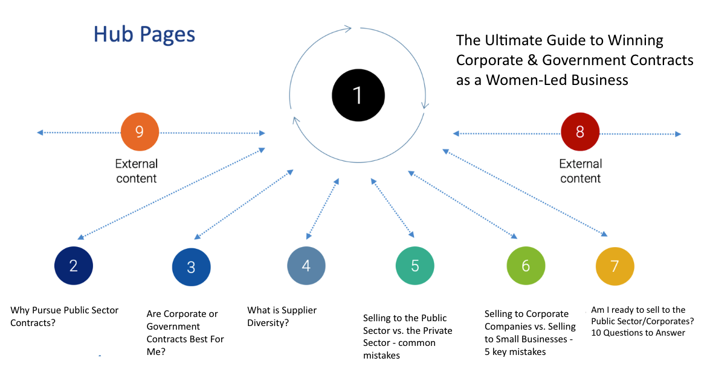

Slide 79
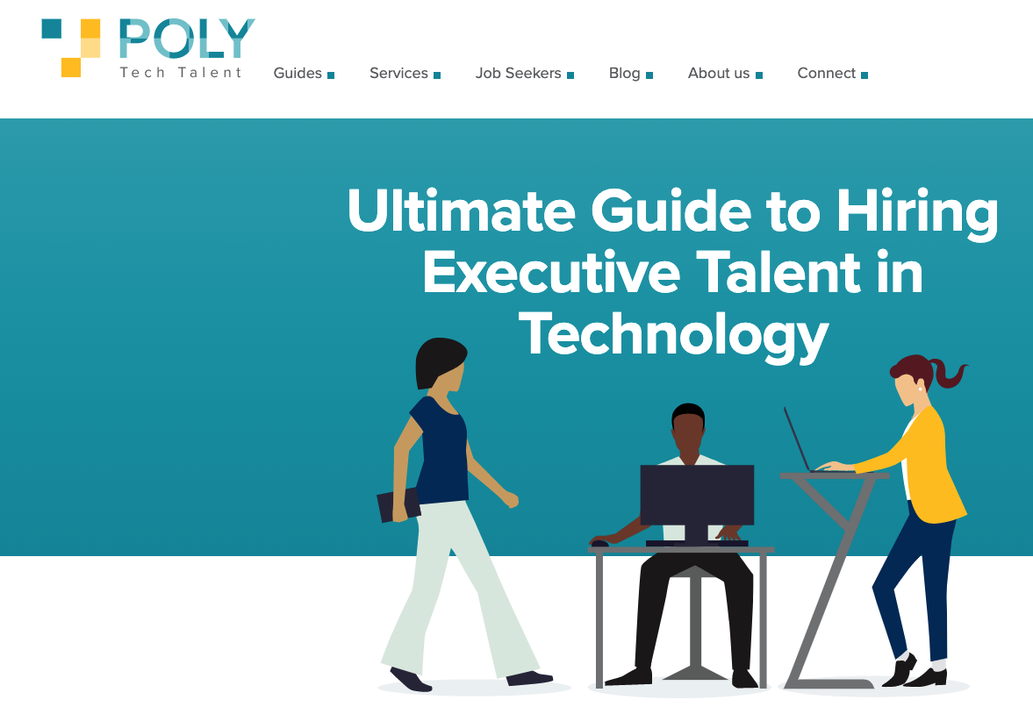
Hub Page Example
Insights:
Hubpages are a way to organize your content. It makes it easy for your persona to find all the information applicable to them in one spot.
The alternative is leaving them to search through your site for content applicable to them. Which unfortunately, they will not do.
Make it easy for your persona to know Function Point supports them, “gets” them, can help them.
https://polytechtalent.com/guide-to-hiring-executive-talent/

Slide 80
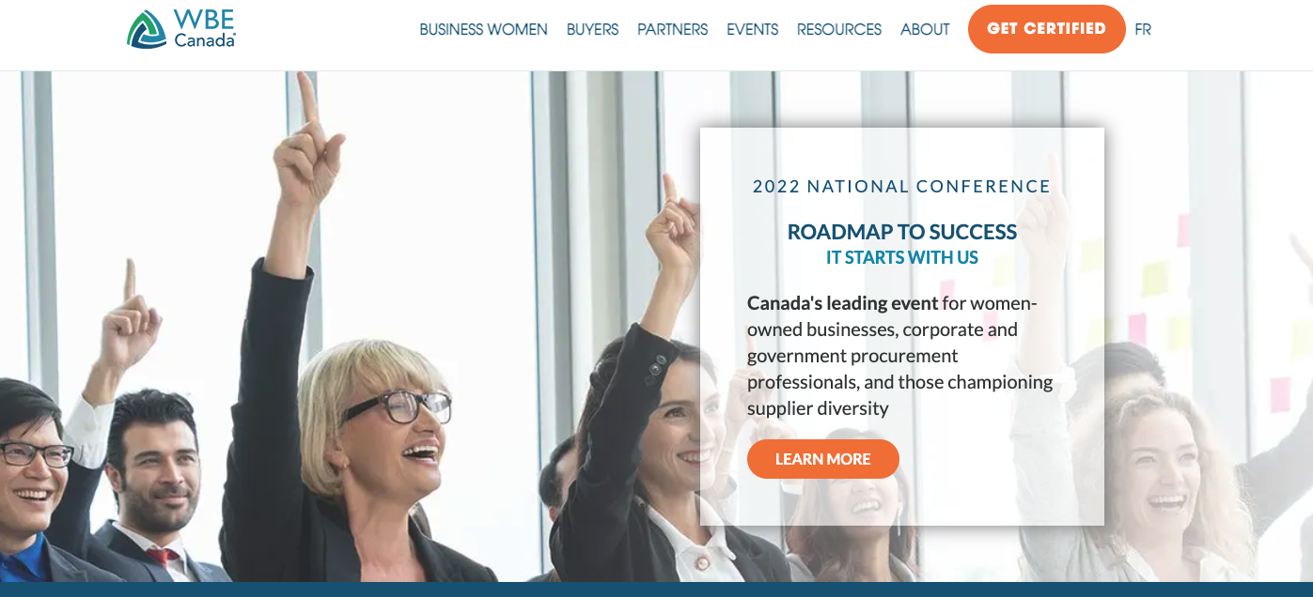
Hub pages could sit in the menu & drop down for each persona
Business Women Corporate Enterprise Public Sector Events Resources About

Slide 81
WBEs Hubpages
  The Ultimate Guide to Growing Your Woman-led Business by Winning Government, Public Sector and Corporate Contracts Sample blog topics:
      Why Win Corporate Contracts?
      Why Win Public Sector/Government Contracts?
      Will Large Business Buy From Small Companies?
      10 Things to Know Before Pitching Corporate Canada
      What to Expect When Selling to the Public Sector
      How Long Does It Take to Win Large Contracts?
      What is Supplier Diversity?
      How to Participate in Supplier Diversity in Canada
      Our Business is not Ready for Corporate Contracts - What Now?
Highlights:
Persona driven content specifically for this targeted buyer.
Easy for sales to direct this buying group to one area on the website
Easy to advertise to this buying group and direct back to website.

Slide 82
Corporates Hubpages
  The Ultimate Guide for Canadian Corporations to Working With Women-Led Businesses to Strengthen the Supply Chain
    Sample blog topics
      What is Supplier Diversity?
      How to Get Started With Supplier Diversity
      When to Roll Out Supplier Diversity During the Fiscal Year
      How to Work With Small Business Owners
      Encouraging Existing Vendors to Incorporate a Diverse Supply Chain
      Who Wins When Corporate Canada Supports Supplier Diversity
      What to Watch out for When Setting Supplier Diversity Quotas
      How to Be a Supplier Diversity Leader in Your Industry
      Why Supplier Diversity Attracts Better Talent to Your Organization
Highlights:
Persona driven content specifically for this targeted buyer.
Easy for sales to direct this buying group to one area on the website
Easy to advertising to this buying group and direct back to website.

Slide 83
Government/Public Sector Hubpages
  The The Ultimate Guide for Canadian Governments & Public Sector Organizations to Working With Women-Led Businesses to Strengthen and Diversify the Supply Chain
    Sample blog topics:
      How Small Business Suppliers Can Support Public Sector Organizations Effectively
      What is Supplier Diversity?
      What does a Diverse Supply Chain look like in Government
      How and Why Should We Work With Small Businesses?
      5 Ways to Know Your Organization is Ready for Supplier Diversity
      Helping Your Small Business Suppliers Through Your Procurement Process
Highlights:
Persona driven content specifically for this targeted buyer.
Easy for sales to direct this buying group to one area on the website
Easy to advertising to this buying group and direct back to website.

Slide 84
Better Content With Interviews - Our Process
  Challenge: Create large volume of content consistently
  Goal: Integrate emotional messaging AND sophisticated, insightful SEO’d writing
  Action Steps: Use the blog interview method to achieve quantity goals while elevating several WBE Canada Employees and/or WBEs / Corporates/Government
    Commit to a 4x per month blog posting cadence following a content plan aligned
    with SEO and your personas.
    The blog works “double duty” as when there is a blog topic about WBEs, Corporates, or the Public Sector, it not only is featured on your blog, but also contributes to the corresponding hub page. This means your 3 main “customer” hub pages are populated consistently with updated information.

Slide 85

Better Blogs With Interviews - Our Process
  SME is interviewed by our writers over recorded Zoom call. 1hr = 2-3blogs/pcs of content
  Draft is reviewed/approved
  Posted on website as blog + image
  Posted on social media in rotation
  1 week later, posted on SME’s LinkedIn as article
    Raises their professional profile with existing & potential clients
    SME builds thought leadership & feels appreciated
    Saves time, SMEs typically enjoy the process
    SME retention, committed, invested in success

Slide 86
Social Media
competitive landscape and what’s next

Slide 87
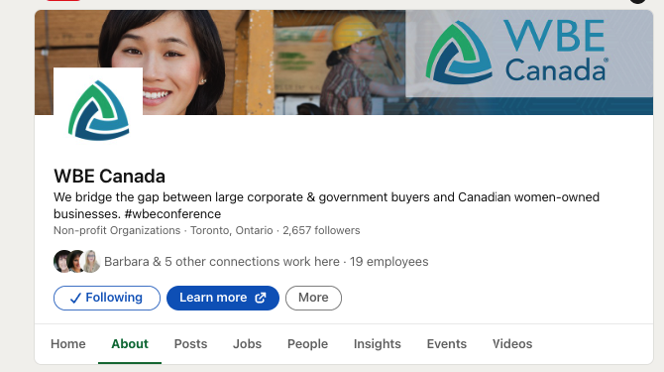

Social Media - LinkedIn Company Page
To do:
  Post daily based on content plan
  Encourage employee engagement on social
  Consider paid ads after 6 weeks of consistent organic increased activity
  Establish the free lead gen form on the company page for interested “potential” WBEs. (easy validation)

Slide 88
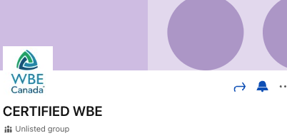
Social Media - Certified WBE LinkedIn Group
To do:
  Suggest moving group to “listed” so that women who are not yet WBEs can be exposed to WBE Canada
  Suggest a cadence of tips/success stories/FAQs/third party articles and posting at different times/days to re-engage the community
  Unlisted groups do not appear in search results for non-group members and are not visible to others on members’ profiles. For all groups, only group members can see group posts.

Slide 89
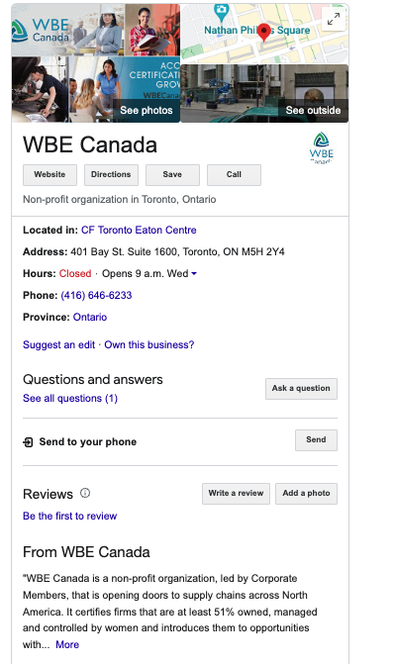
Social Media - Google Business Profile
  To do:
    Officially claim the listing
    Post your blogs and other content on a 7 day rotation
    Use the 1500 character field in every post to include keywords and information about WBE Canada
    Post additional association information - there is room for a lot of information to share
    Fill the listing out fully to take advantage of its ability to promote your association (Google property)
    Free!

Slide 90
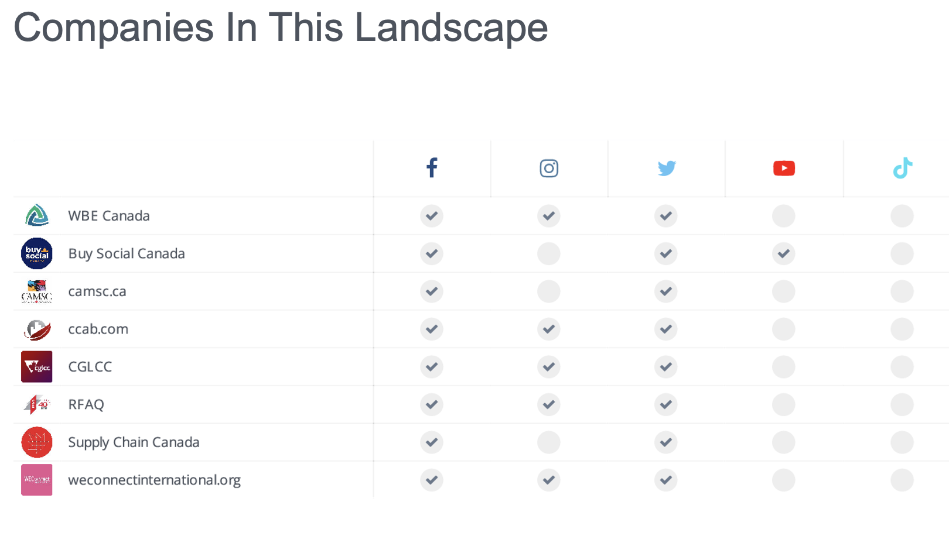

Slide 91
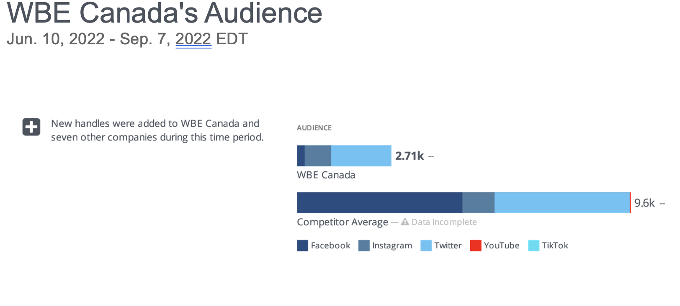

Slide 92
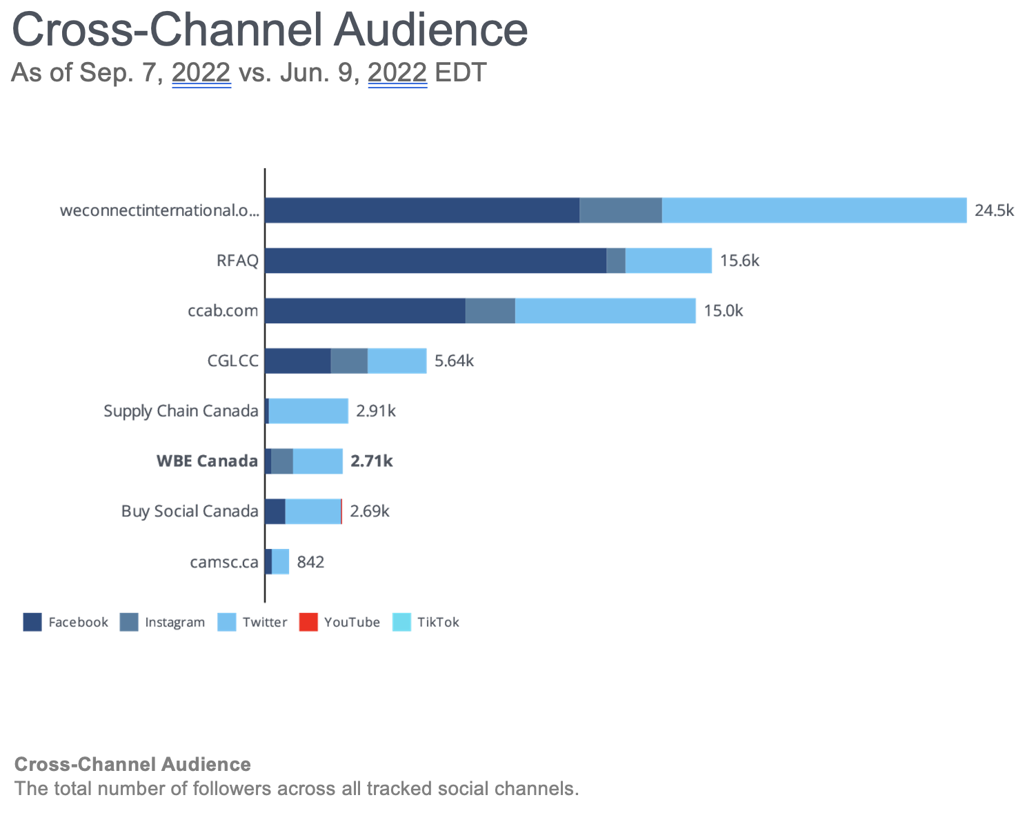

Slide 93
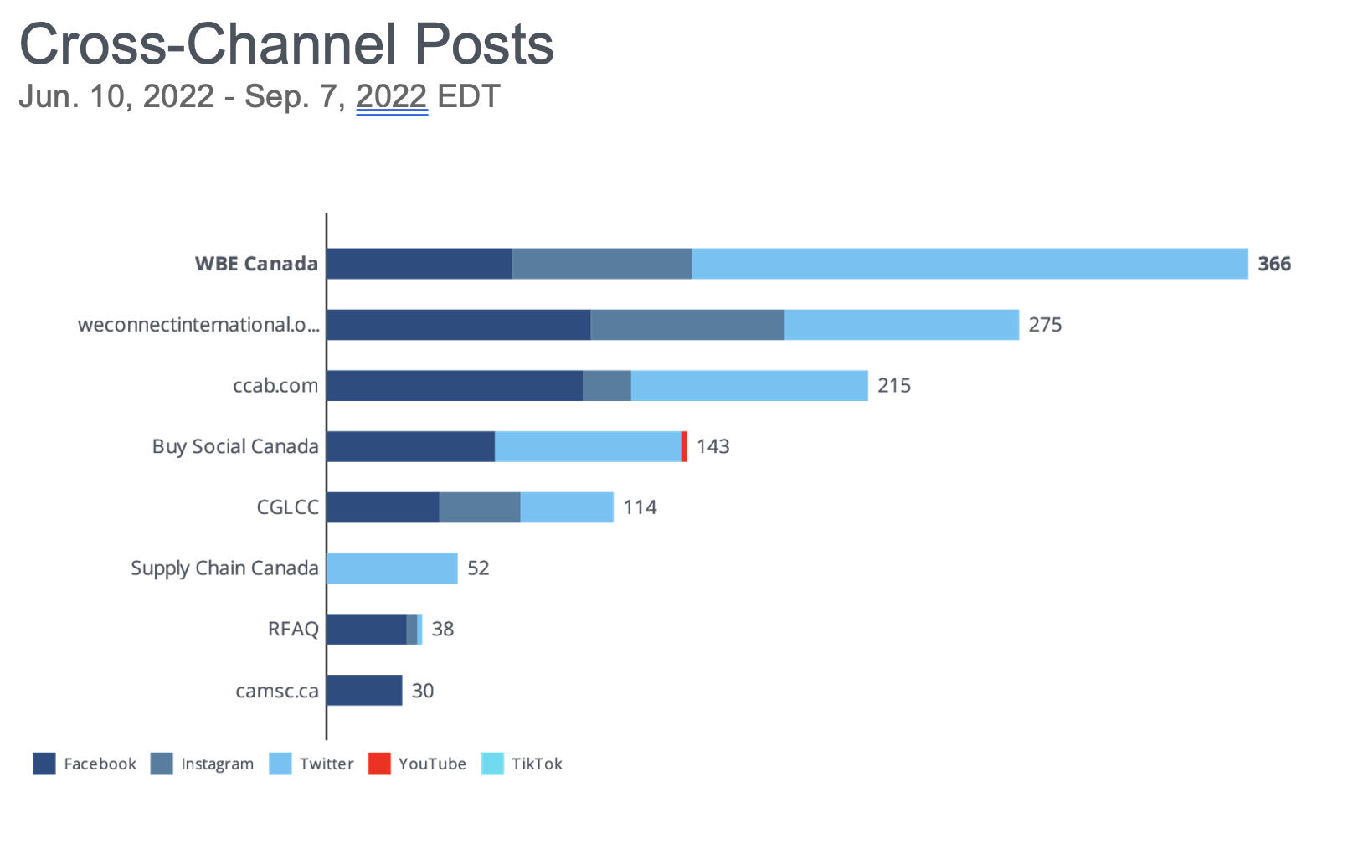

Slide 94
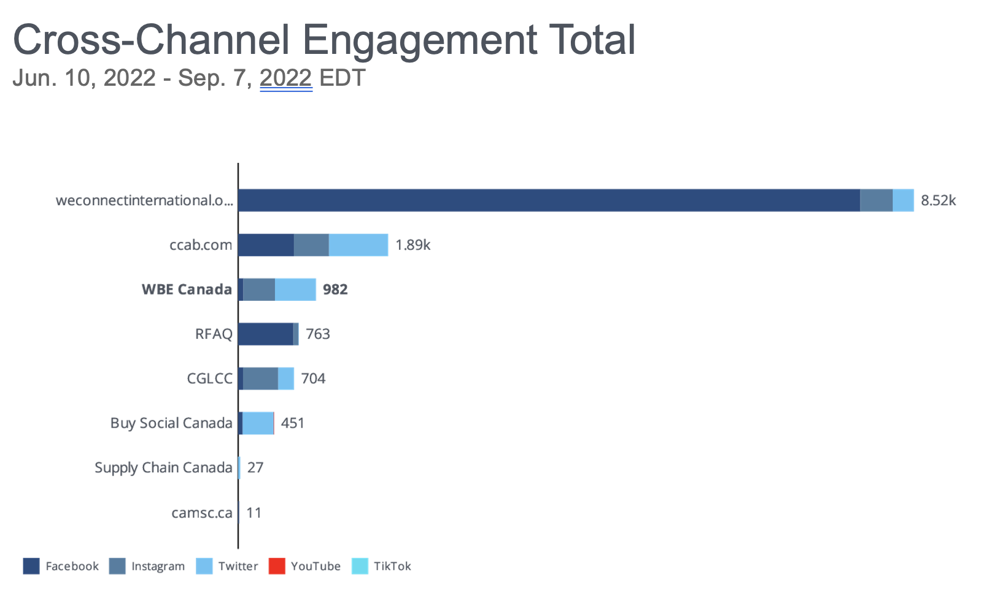

Slide 95
Ads & Sponsorships
what to consider

Slide 96
Awareness Advertising/Sponsorships
    Keywords - now that we’re not so focused on “Procurement” or “Supply Chain” as key words, we are more focused on the decision-making process of the potential WBE since that is the fastest type of “customer” to win over…suggest keyword research start from discovery:
      How to grow my Canadian Business
      What networking organizations to join to grow my business?
      Women business owner opportunities
      Best organization to belong to as a woman business owner
      >>>focus on construction
      >>>focus on catering
  Action step - commission keyword research and develop ads and content based on keywords, rewrite

Slide 97
9 Canadian Construction Associations
    Canadian Electrical Contractors Assoc: https://ceca.org/
    Surety Association of Canada: https://suretycanada.com/
    Canadian Roofing Contractors: https://roofingcanada.com/
    Canadian Institute of Steel Construction: https://www.cisc-icca.ca/
    Canadian Federation of Construction Safety Associations: https://cfcsa.ca/
    National Capital Heavy Construction Association: https://cfcsa.ca/
    Project Management Association of Canada: https://pmac-agpc.ca/
    Canadian Home Builders Association: https://www.chba.ca/
    Canadian Construction Association: https://www.cca-acc.com/
    Canadian Association of Women in Construction: https://cawic.ca/
    Women in Construction: https://www.women-in-construction.ca/
Action step - reach out to attend/sponsor/educate/get known to this sector

Slide 98
6 Canadian Catering/Food Associations
    Restaurants Canada: https://www.restaurantscanada.org/
    Canadian Restaurant and Foodservice Association: https://www.hospitalitynet.org/organization/17003657.html
    Ontario Restaurant Hotel and Motel Association: https://www.orhma.com/
    Canadian Association of Professional Sommeliers: http://sommelierscanada.com/
    Canadian Professional Bartenders Association: https://canadianbartenders.com/
    Canadian Culinary Association: https://www.canadianculinaryinstitute.ca/canadian-culinary-federation.html
Action step - reach out to attend/sponsor/educate/get known to this sector

Slide 99
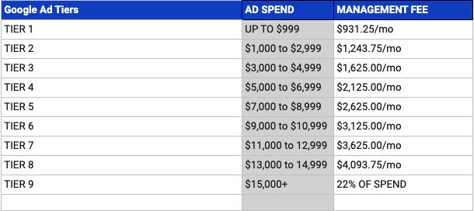
Example Google Ads Pricing

Slide 100
Reporting
what to measure

Slide 101
Reporting
WBE Canada’s current reporting metrics
WBEs - Recommended items:
  Traffic to website
    Top landing pages
    Traffic by source: Organic, Paid, Referrals, Social Media Sites, Email, etc.
  Email sign-ups on website
  Tools for Growth sign ups per month
  Certification call requests per month
  Certification applications per month
  Marketing activities each month
  Specific campaign metrics

Slide 102
What’s In It For WBE Canada?
why do all this work?

Slide 103
Content keeps working for you 24/7…
  targeted messaging
  48+ blogs with images
  3 persona hub pages
  192+ social posts tailored for each social media channel (we can hand off to the internal team)
  your audience is consistently online
  timeless content themes (appropriate 6 days, 6 weeks, 6+ months after posting initially)

Slide 104
Action Plan

Slide 105
Action Plan
Marketing Foundation:
  Messaging & Positioning:
    Create a messaging & persona guide
    Review and update website, social media & foundational marketing assets for new high level WBE messaging
    Update website to make the WBE Certification & Pre-Certification options clearer
  Online Listing and Review Sites: Identify and update with new positioning and messaging/claim Google Business listing and any other identified listing sites.
  New Persona Marketing Funnels:
    Set up four new persona marketing funnels, including Landing Pages, Thank You Pages, Auto-Responders and email nurturing sequences
    Begin with the WBE Certification Persona

Slide 106
Action Plan
Awareness Campaigns:
  Keyword Research and On Page SEO:
    Conduct keyword research and update the on-page SEO for all website pages
  New Persona SEO Hub Pages
    Begin with the WBE Certification Persona - ongoing project
Content Marketing:
  Updated/New Core Content Piece Monthly
  Four weekly blog posts (one SME interview, 3 from content piece)
  Social sharing
  Monthly LinkedIn article
  Weekly newsletter

Slide 107
Action Plan
Lead Generation Campaigns:
  Facebook and LinkedIn Advertising
    Targeting WBEs to both create awareness and leads - leading to the WBE Certification Funnel
    Targeting key WBE niche industries to bring in more WBEs - leading to the WBE Niche Funnel
  Association Marketing
    For all personas, create association marketing campaigns leading back to the appropriate funnels
    Create an association marketing template kit
    Identify and select one association per persona to target monthly
    Select and execute lead generation marketing activities

Slide 108
Action Plan
Referrals & Retention:
  Engagement & Communication:
    Create a communication guide & recommended process to improve engagement (to be implemented by staff)
  Onboarding & Expectations:
    Create a welcome kit and onboarding process (to be implemented by staff)

Slide 109
By the end of the year… you’ll have:
  Marketing Foundation:
    Updated website & online content reflecting high level messaging that all WBEs can relate to
    More clear process on the website so more WBEs will convert to Certification or Tools for Growth
    Four new persona marketing funnels, including landing pages, thank you pages, updated content and lead nurturing sequences
  Content Marketing:
    48 new blog posts
    1152 new social posts (and LinkedIn articles), many driving back to the website and lead nurturing sequences
  Awareness:
    Three new persona Hub Pages increasing SEO and conversions
    Dedicated outreach to construction & catering associations
  Lead Generation:
    Two social advertising campaigns running (each on Facebook & LinkedIn) driving traffic back to the WBE Certification Funnel and the WBE Niche Funnel
    Association Marketing Kit with core messaging and templates for ads, blurbs, news releases, sheet
    Directly targeted and contacted 10+ associations
    Dedicated outreach to one key industry niche - such as construction or catering

Slide 110
Next Steps

Slide 111
Next Steps:
  Revise strategy based on feedback today
  Deliver strategy & action plan
  Deliver proposed budget, resourcing and timelines for approval
  Following approval - meet with team and get started!

